Slide 1
FACE RECOGNITION FOR SECURE ONLINE PAYMENT WITH PROXY DETECTION
SARATH KUMAR S (921317104192)
SANTHOSH LUITEL (921317104191)
SANTHOSH S (921317104187)
SANTHOSH S (921317104186)

Slide 2
Objective
The purpose of our project is to develop a web based application which is used for online payment in a more secure way. Instead of OTP generation the online payment is enabled by face recognition of the user.

Slide 3
Introduction
Online Secure Payment using Face Recognition is a web based application which enables a more secure online money transaction.
The advancements in technology have led to a surge in online transactions via online shopping, internet banking, payment gateways, etc.
In the current world of advanced technology, it is easy for hackers to get personal details of users because of which some people are hesitant to use online transactions. This makes security an important factor at the time of making digital payments.
For this reason, to make transaction more secure we use face recognition instead of OTP or MPIN.
Facial recognition has improved dramatically in recent years and the best face identification algorithm has an error of just 0.08% making it more reliable and secure than OTP.

Slide 4
Abstract
Face Recognition for Secure Online payment with Proxy Detection will be implemented for payment to online merchant.
The transaction permits in this study lie in the biometric face verification transaction permission and Mobile number to improve communication security and transaction data.
Registered mobile of the retailer to carry out transaction permits with Face verification transaction permits.
Face Verification will be implemented using Face Net Deep Learning Algorithm.

Slide 5
Literature Survey
Title | year | Description
Swing-Pay: One Card Meets All User Payment and Identity Needs | 2017 | This paper, presents an approach and module by which one card can communicate with another using near-field communication (NFC) technology to digitally transfer money from the payer’s bank to the payee’s bank. This approach eliminates the need for physical cash and also serves all types of payment and identity needs. Embodiments of this approach furnish a medium for cashless card-to-card transactions.

Slide 6
Literature Survey
Title | year | Description
A Biometric based Payment System by using Payee and Payer Module | 2017 | This paper provides an approach and module by which one payee module can communicate with the player module using Bluetooth for money transfer from the payer’s to the payee’s bank. The significance of this approach is that it eliminates the physical need of case cash and serves for all types of payment and identity needs.

Slide 7
Literature Survey
Title | year | Description
Surveying the Development of Biometric User Authentication on Mobile Phones Surveying the Development of Biometric User Authentication on Mobile Phones | 2015 | we survey the development of existing biometric authentication techniques on mobile phones, especially on touchenabled devices, with reference to eleven biometric approaches (ﬁve physiological and six behavioral). We present a taxonomy of existing efforts regarding biometric authentication on mobile phones and analyze their feasibility of deployment on touchenabled mobile phones.

Slide 8
Existing system
Existing system was implemented using face encryption and decryption to avoid hackers while transaction.
Existing System used Azure API face verification
Limitation of existing systems are proxy detectors was not implemented, even if people show their photo image it could able to recognize the face and completes the transaction. This leads to major thread of the process.

Slide 9
Proposed System
In the proposed system, Face Verification will be implemented using Face Net Deep Learning Algorithm to embed with 128 feature points of the face.
Embed 128 features point of each person face will be calculated with triplet loss function.
Facial features of every person will be classified using SVM.
Advantage of our proposed system is Proxy Detection will be implemented using image processing technique. This provided more secure to the system.

Slide 10
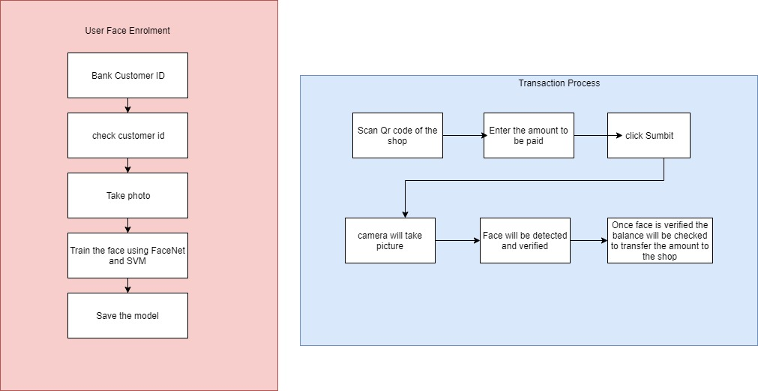
System Architecture

Slide 11
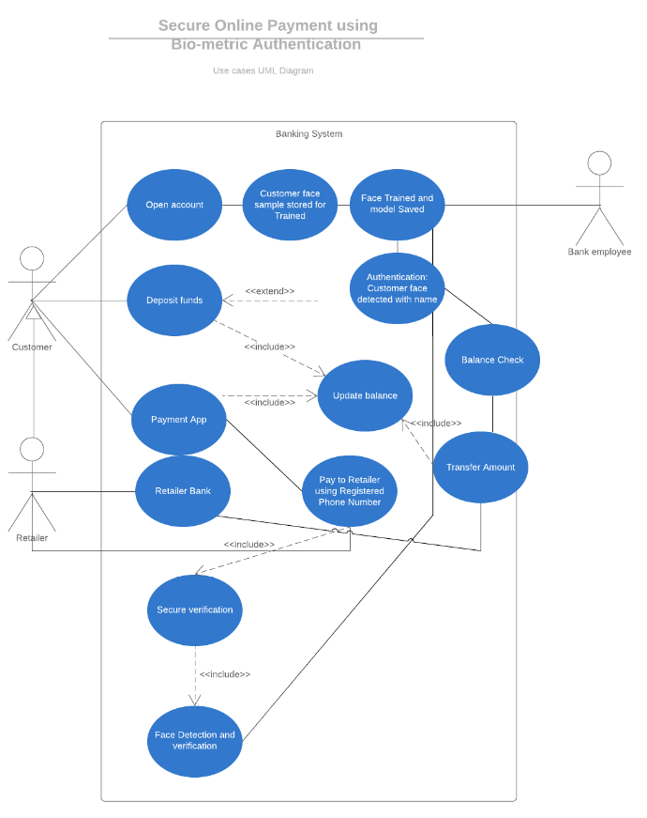
Use case Diagram

Slide 12
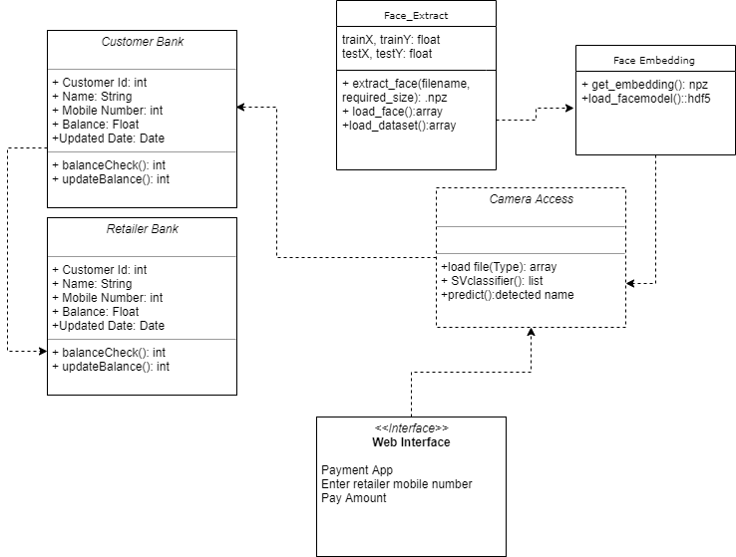
Class Diagram

Slide 13
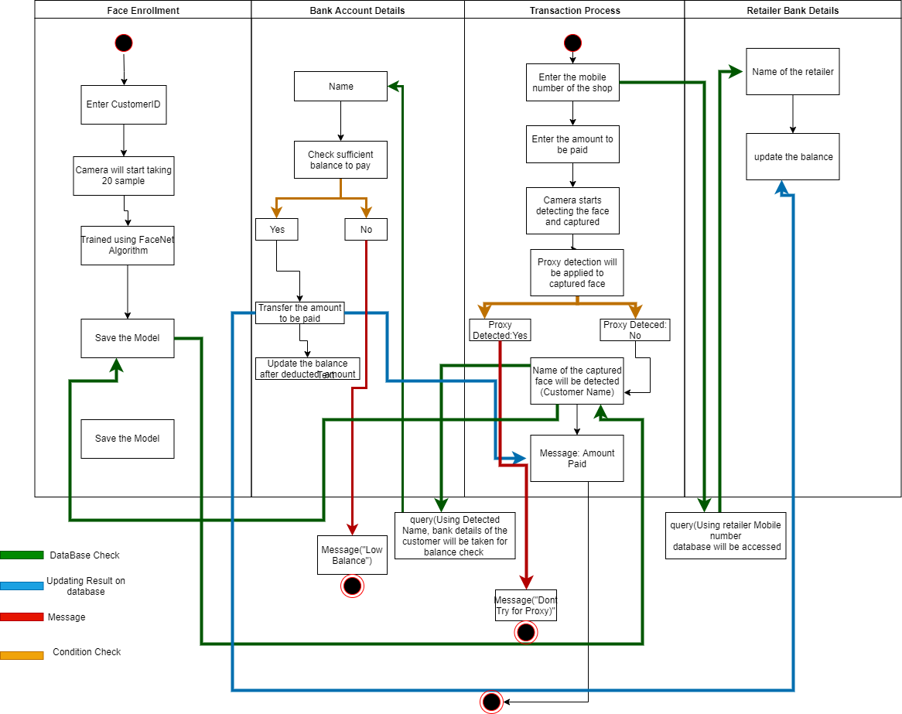
Activity Diagram

Slide 14
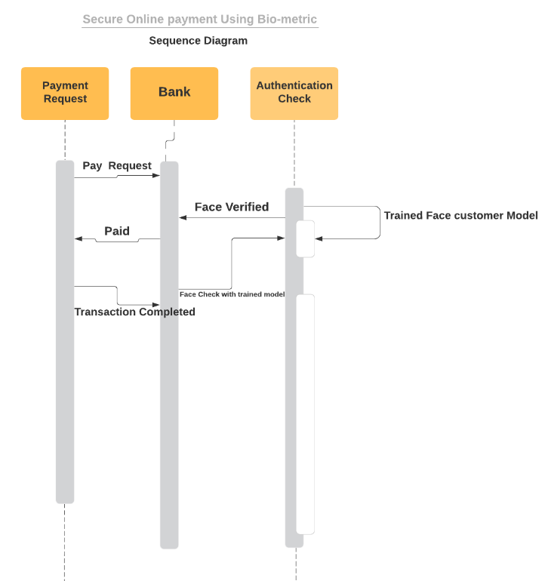
Sequence Diagram

Slide 15
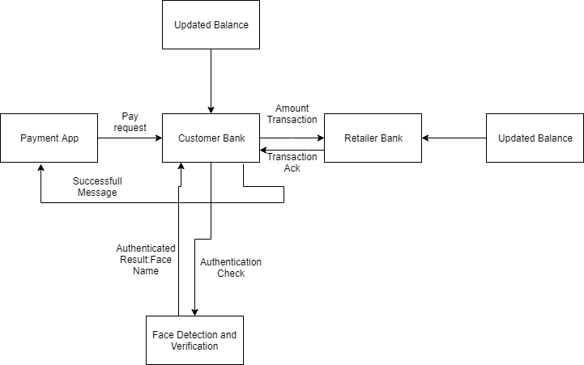
Collaborative Diagram

Slide 16
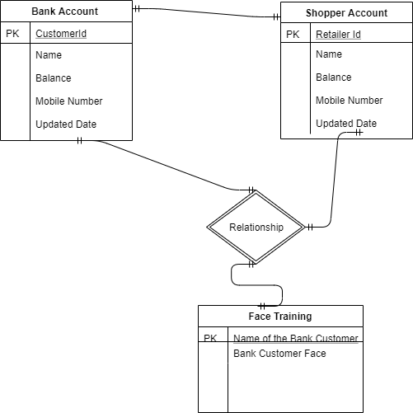
E-R Diagram

Slide 17
Module-1: Face Enrolment
Face enrolment
From bank side separate database will be maintained for face detection and verification.
Sub module-1: Input data collection
Each bank customer will have 20 sample photos for training the face. Photo will be taken at the time of when customer opened the account.
Sub module-2: Training the collected input data
Face will be trained using FaceNet Algorithm which works on triplet loss.
Sub module-3: Classification
Extracted face will be classified using SVM classifier.

Slide 18
Module 2: Transaction Process
Sub-module 4: Payment process input
When customer have to pay , customer will enter the registered mobile number and the mobile number of the retailer shop , and the enter the amount to be paid.
Sub-module 5: cross checking the captured face
Camera will starting detecting the face of the bank customer and verify with trained face. Detected face will be compared with trained model.

Slide 19
Module-2: Transaction Process
Sub-module 6:Proxy Detector
In between the verification process, detected face is proxy or real face will be detected. If proxy is detected then transaction will be not be completed. Detected name will be compared with entered customer phone number, for confirmation.
Sub-module 7: Balance Check
Once it confirmed, sufficient balance will be checked to transfer the amount. Finally it will transfer the money to retailer shop.

Slide 20
Database Design
Name of the Database | Attributes
Customer Bank Details | Customer ID Name Balance Mobile Number Updated Date
Retailer Bank Details | Customer ID Name Mobile Number Balance Updated Date
Face Enrolment | Customer face folder

Slide 21
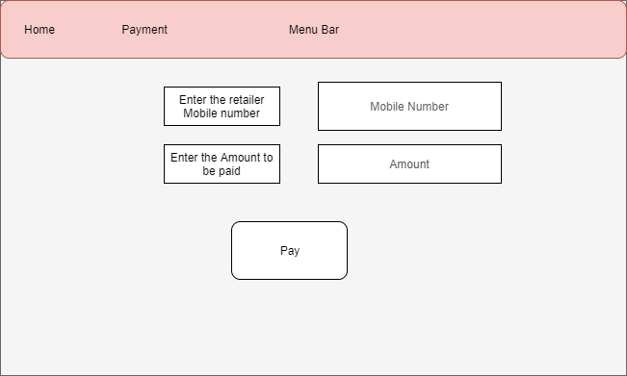
Input Design

Slide 22
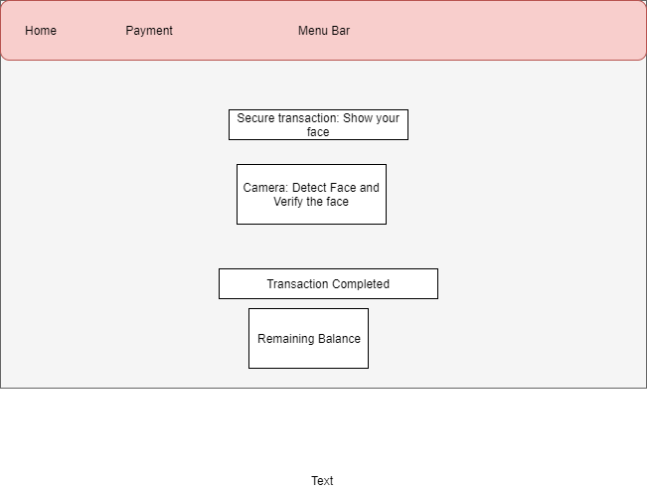
Output Design

Slide 23
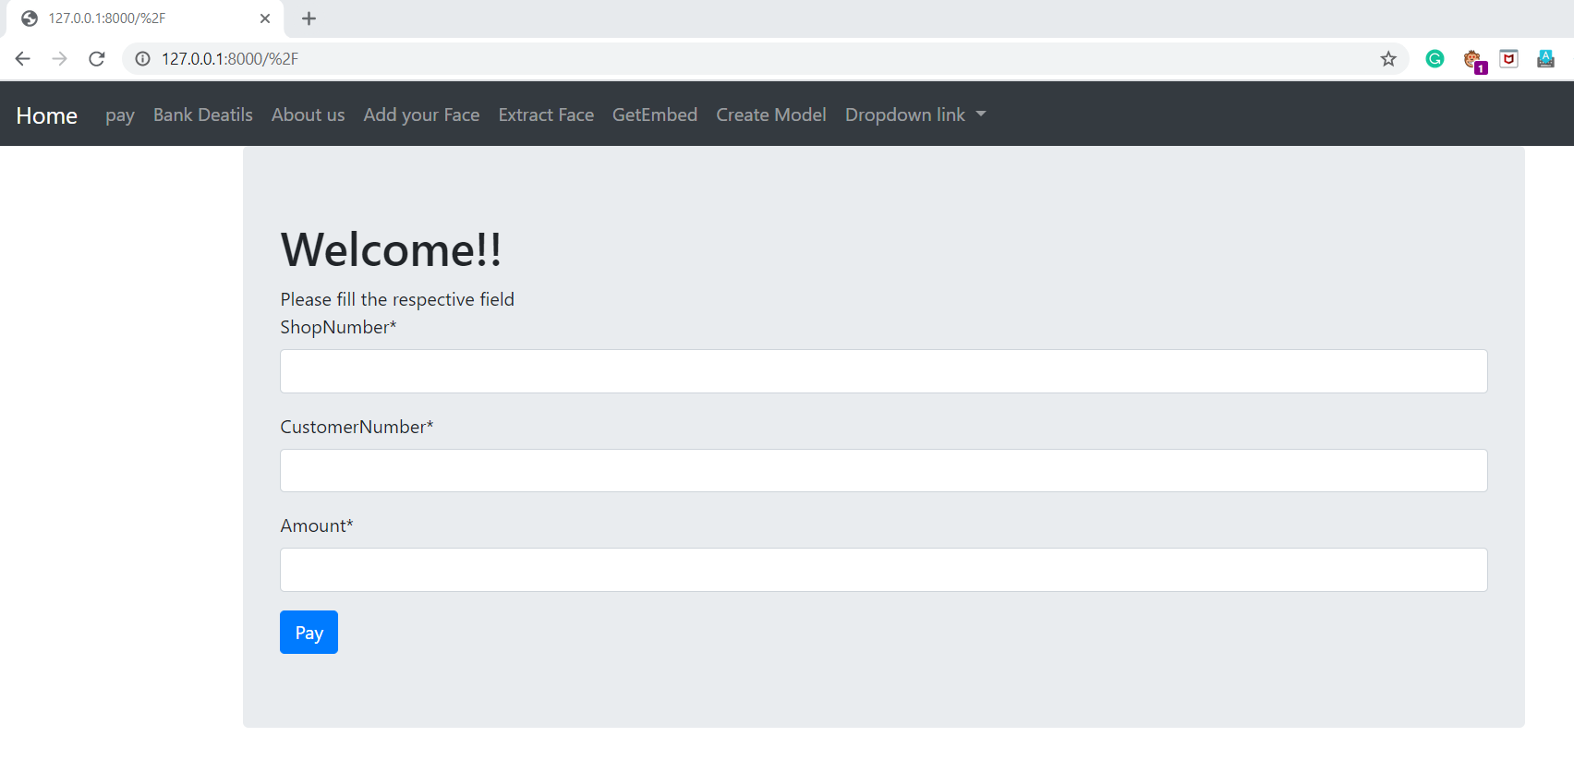
Input UI

Slide 24
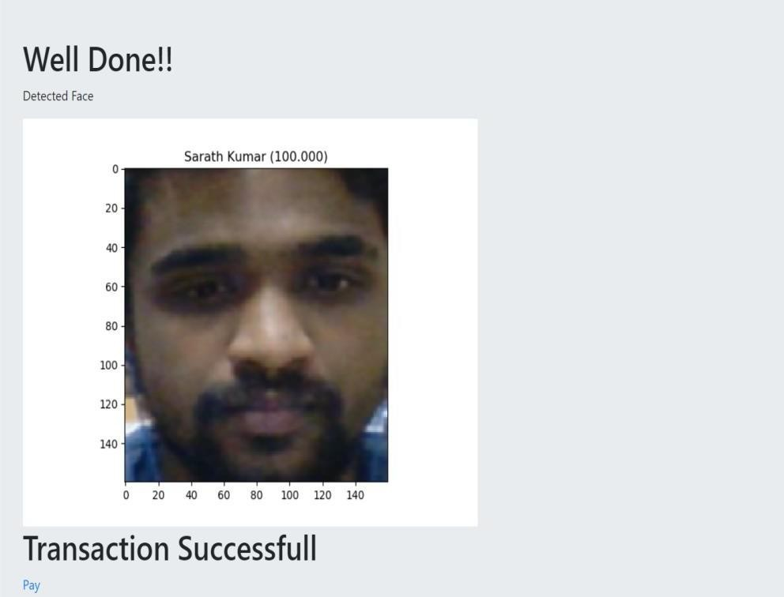
Output page

Slide 25
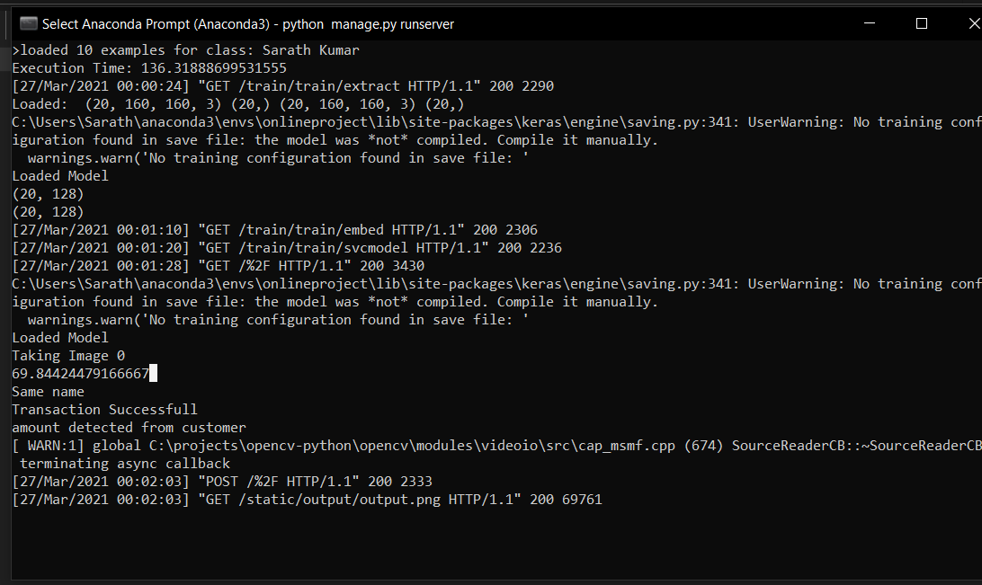
Console Output

Slide 26
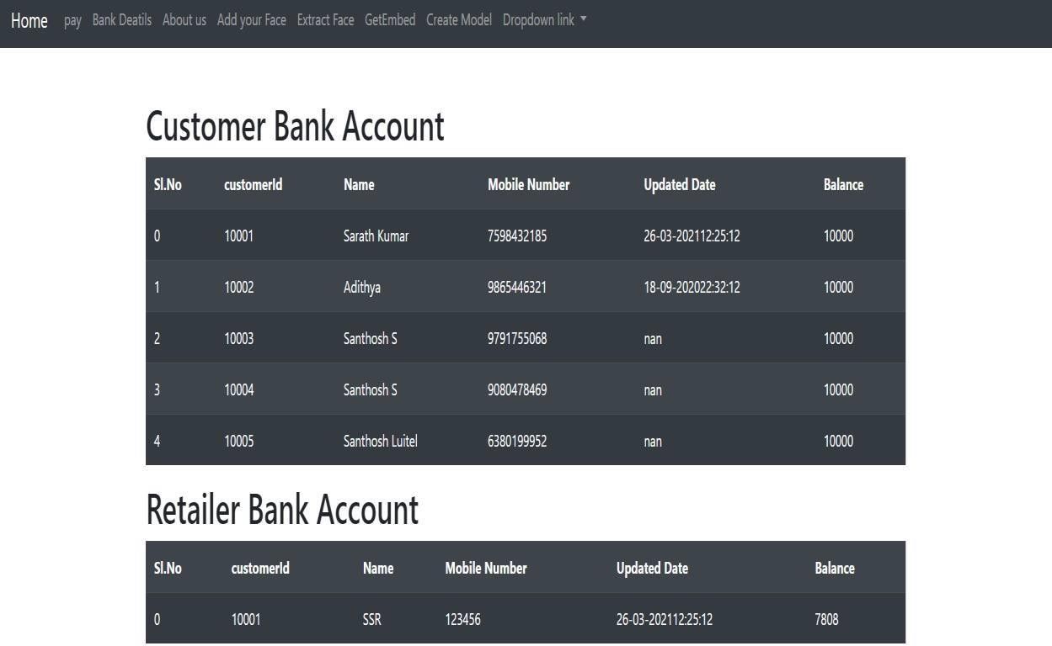
Database: Customer and Retailer

Slide 27
System Requirements
Operating System : Windows 32 bit or 64 bit OS
Ram : 4 GB
Speed : 2.40GHz
Camera : External or inbuilt webcam enabled
Front End : Django
Back End : csv files
Tools : Spyder

Slide 28
Advantages
Only with live face payment will be completed.
No need to share the OTP for friends and family.
Proxy Detector is included, if showing any photo in front the prediction system, it automatically detect the proxy and placement will not be completed.
Secure payment is established.

Slide 29
Disadvantages
Implementation in the real time, to change entire process maybe difficult.
Training time may take longer for the large dataset.
Dataset of the customer face at least need 20 for each.

Slide 30
Conclusion
The proposed system was successfully able to transit the amount to the retailer with proxy detector.
Proxy detector was implemented in the system and tested.
Proxy detector improves the security the system.

Slide 31
Future Scope
The proposed system gives a method for online transaction security using facial recognition. The system can be developed to automate the process. Some future enhancements for the proposed system can be:
Improving the system for banking transactions.
To add some more feature to make the transaction secure.
More efficient Object Detection Neural network.
To implement the system in a banking and online transaction web is not more convenient so develop the app for this application.

Slide 32
References
Badan pusat statistika Indonesia, “tingkat kemiskinan“, access February 11 2019. Available: https://www.bps.go.id.
Ahmad Amran, Surya Michrandi Nasution, Fairuz Azmi,” Implementation of Cryptography Algorithm For Biometric Payment”. E-proceeding of engineering, Vol.3, No.1 April 2016.
Phil Tresandern and Timothy F. Cootes,” Mobile Biometrics: Combined Face and Voice Verification for the mobile platform”, IEEE, Books, 2013.
Selvia Rahmawati1, Ichsan Taufik, Gitarja Sandi,” Implementasi Algoritma AES(Advanced Encryption Standard)256Bit Dan Kompresi Menggunakan Algoritma Huffman Pada Aplikasi Voice Recorder”, SENTER 2017, 15-16 Desember 2017.
Microsoft Azure,“Face API Azure Cloud documentation” access February 2019.Available:https://www.azure.microsoft.com.
J.Zhou, X.G.Lu, D. Zhang, C. Wu, Orientation analysis for rotated human face detection, Image and Vision Computing, 20, 2002, 257264.
Weizhi Meng; Wong, D.S.; Furnell, S.; Jianying Zhou,"Surveying the Development of Biometric User Authentication on Mobile Phones," in Communications Surveys & Tutorials, IEEE, vol.17, no.3, pp.12681293, third quarter 2015. [

Slide 33
THANK YOU

